Slide 1
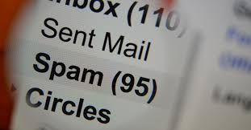
Classification of Ham & Spam Messages through NLP
Rahul Pahuja Capstone 2

Slide 2
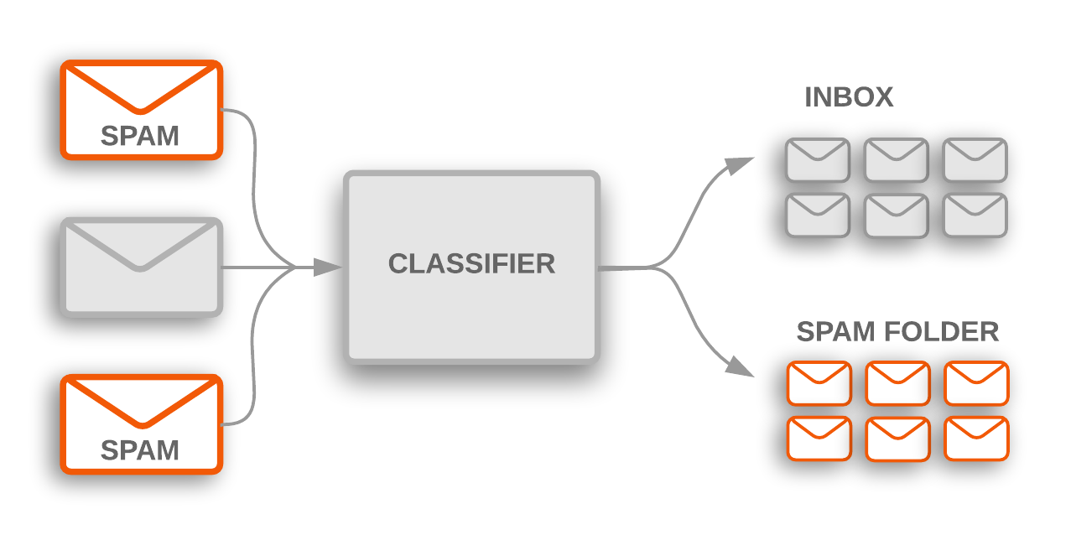
What’s the difference in ham and spam contents?
The Problem
The SMS Spam Collection is a set of SMS tagged messages that have been collected for SMS Spam research. It contains one set of SMS messages in English of 5,574 messages, tagged as either ham (legitimate) or spam.
We have to train a model which may classify any given message as a ham or spam. This whole
dataset can be used for the training of the classifier.

Slide 3
The features we have
Labels : Ham and Spam
Messages

Slide 4
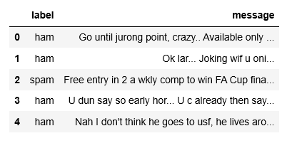
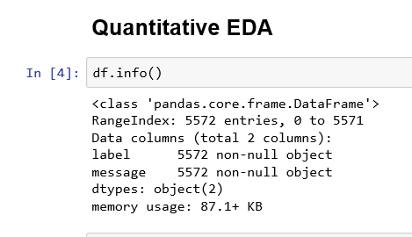
Data Information

Slide 5
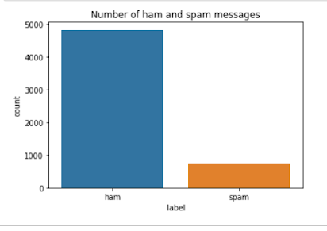
Amount of Ham vs Spam data we have
City B has the most transactions and City A has the least number of transactions among the 3. It has more purchase on an average

Slide 6
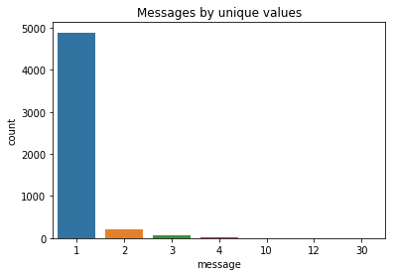
Most of the messages are unique except for the few which have been repeated 2,3,4,10,12, and 30 times.

Slide 7
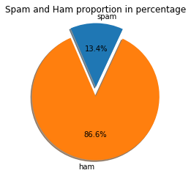
Ham – Spam share in the dataset

Slide 8
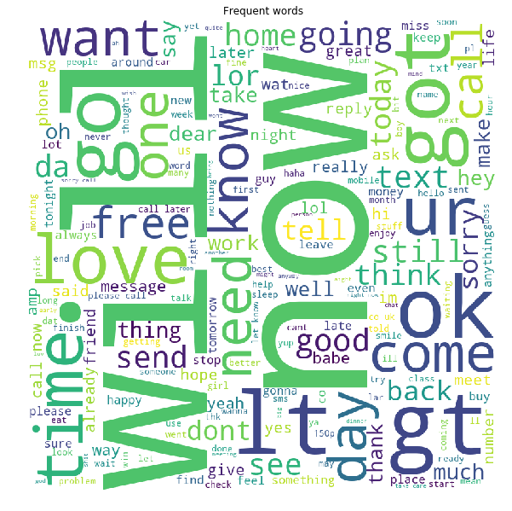
Word Cloud of the words used in all the messages of the dataset.

Slide 9
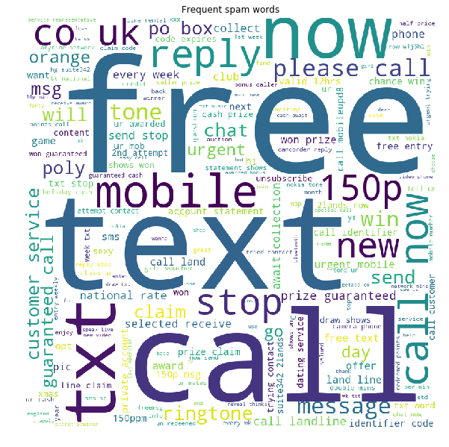
Word Cloud showing frequent words in spam messages

Slide 10
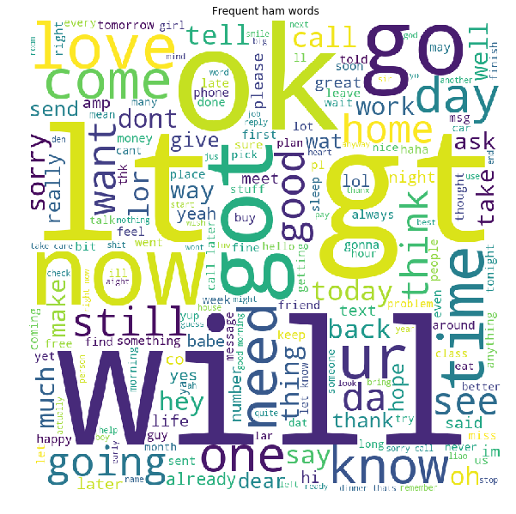
Word Cloud showing frequent words used in ham messages

Slide 11
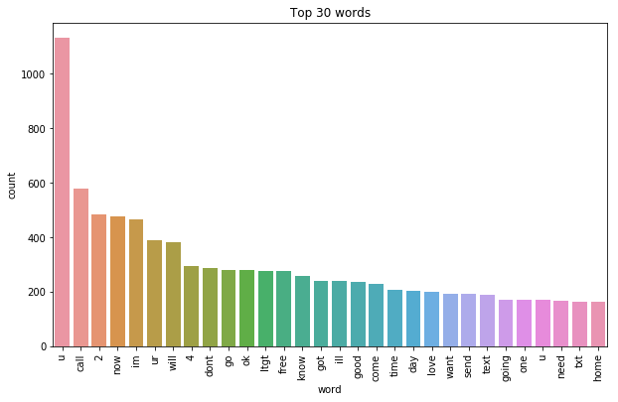
Top 30 words

Slide 12
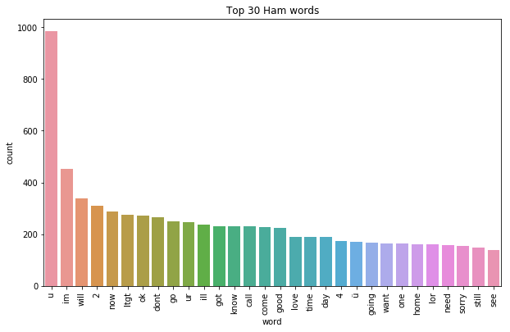
Top 30 ham words

Slide 13
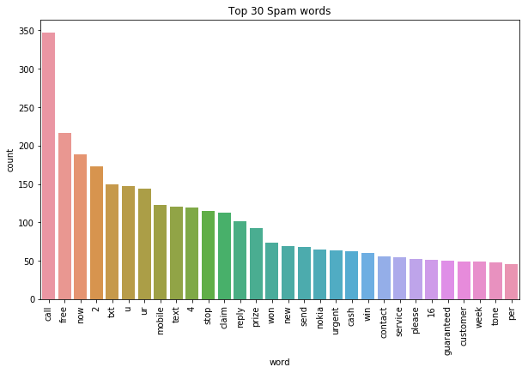
Top 30 spam words

Slide 14
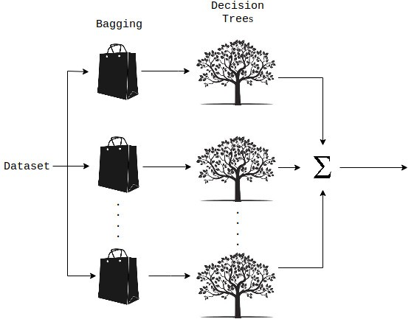
Modelling
Steps
Bag of words technique is used
Data is tokenized, stopwords are removed, vectorized, and weighted.
Random Forest Classifier is applied as it is the most accurate.
Cross validation was also performed
Hyperparamters are tuned
The best parameters: 'n_estimators': 31, 'random_state': 51

Slide 15
Conclusion
Out of all models used Random Forest was the most accurate with average accuracy after cross validation around 97.5%
With more ideas, the model can be improved in the future.

